Slide 1

Hierarchical clustering (Agglomerative)
Or ELIYAHU

Slide 2
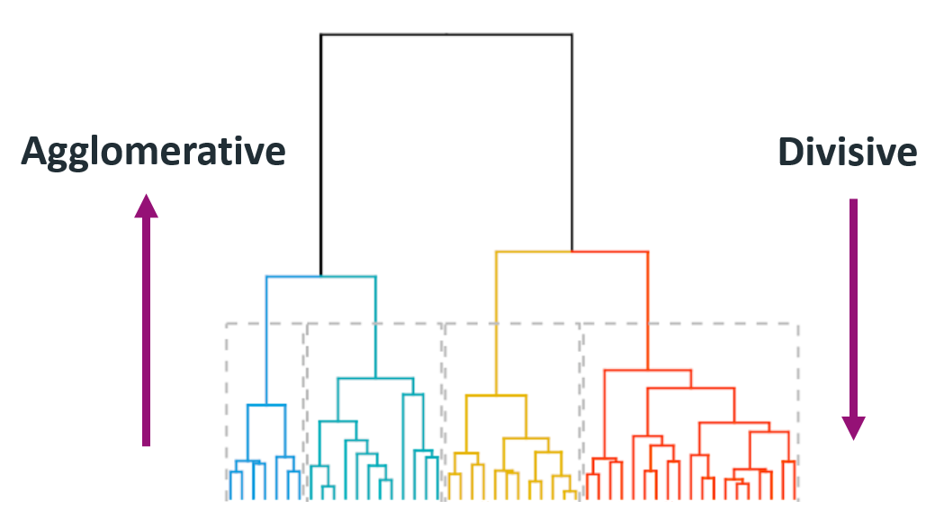
Introduction
Algorithm
Pseudocode
How it works
Algorithm optimization
Code optimization
Pros and Cons of the programming languages
Runtime comparison
Implementation

Slide 3
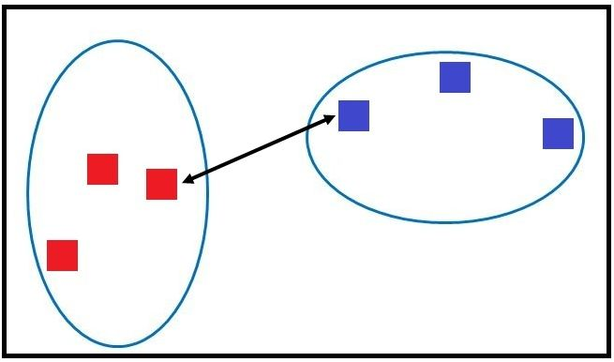
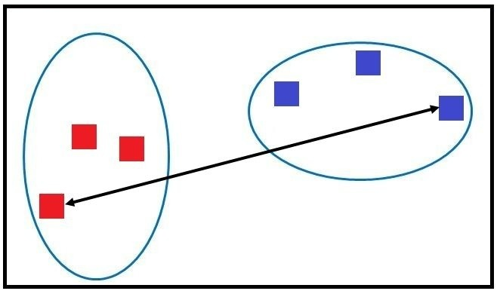
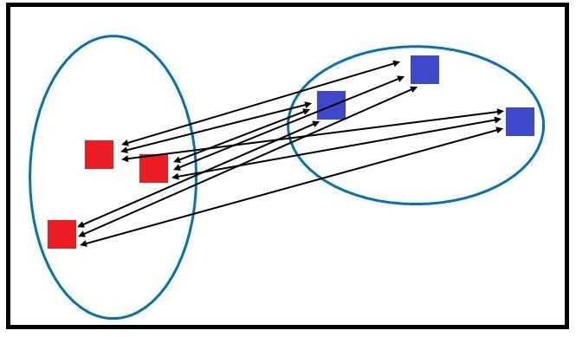
Algorithm - Types of Linkages
We require to find the among the clusters. This is done by calculating the distance between the clusters. There are multiple ways of calculating the distance such as Single Linkage, Complete Linkage and Average Linkage
Single Linkage - The proximity between the two clusters by calculating the shortest distance between them.
Complete Linkage - It is the opposite of Single Linkage where we consider the two farthest points of both the two clusters.
Average Linkage – We calculate the average distance from each data point of a cluster to all the data points of the other cluster.
Single Linkage (Nearest Neighbour)
Complete Linkage (Farthest Neighbour)
Average Linkage

Slide 4
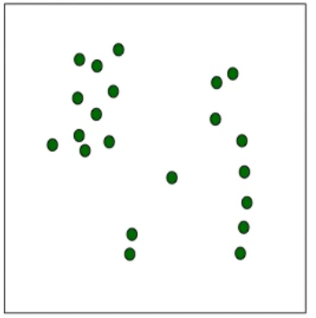
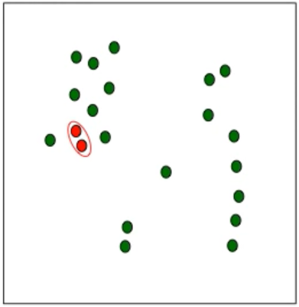

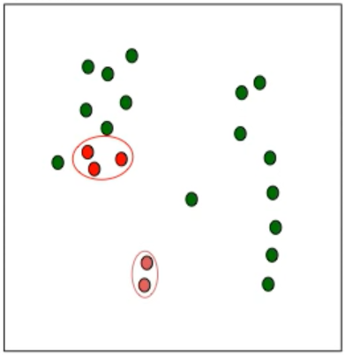
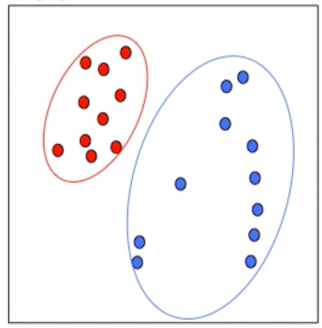
Algorithm
k = 2,
num_current_clusters = 21
k = 2,
num_current_clusters = 20
k = 2,
num_current_clusters = 19
k = 2,
num_current_clusters = 18
Final result:
k = 2,
num_current_clusters = 2
…

Slide 5
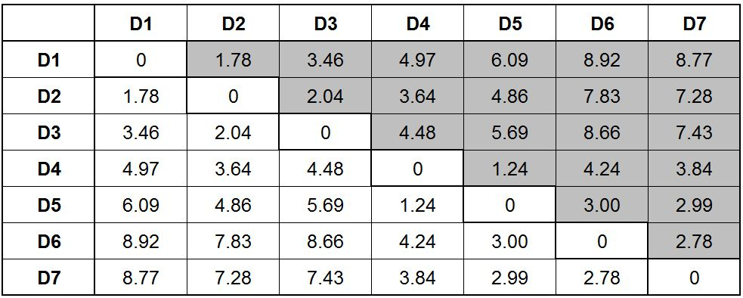
Hot it works
Input: NxN matrix (distance matrix), n_clusters (number of clusters)
Output: Vector that represents each point its classification
Input, n_clusters = 2
Output
[0, 0, 0, 1, 1, 1, 1]

Slide 6
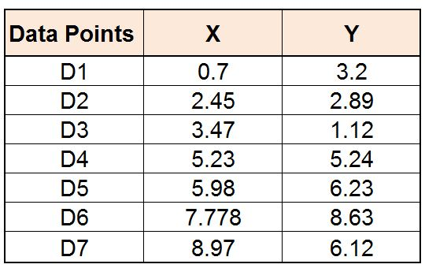
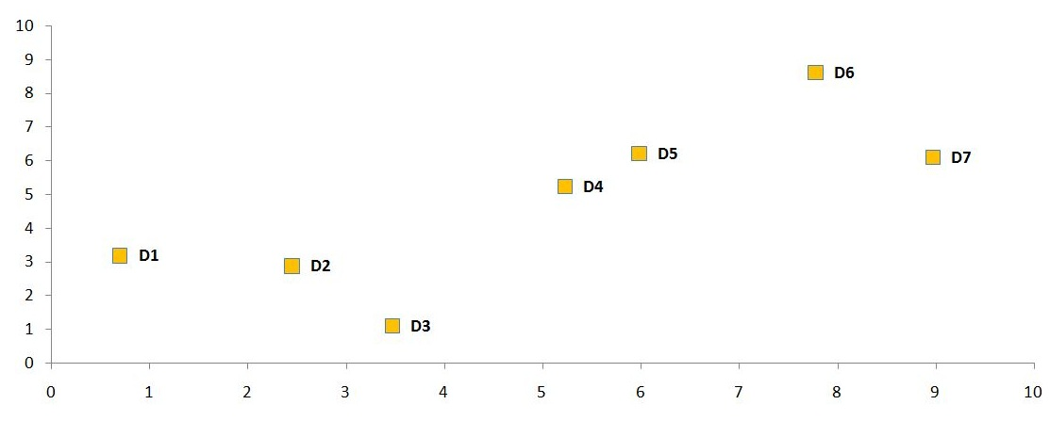
Hot it works
Input: NxN matrix (distance matrix), n_clusters (number of clusters)
Output: Vector that represents each point its classification

Slide 7
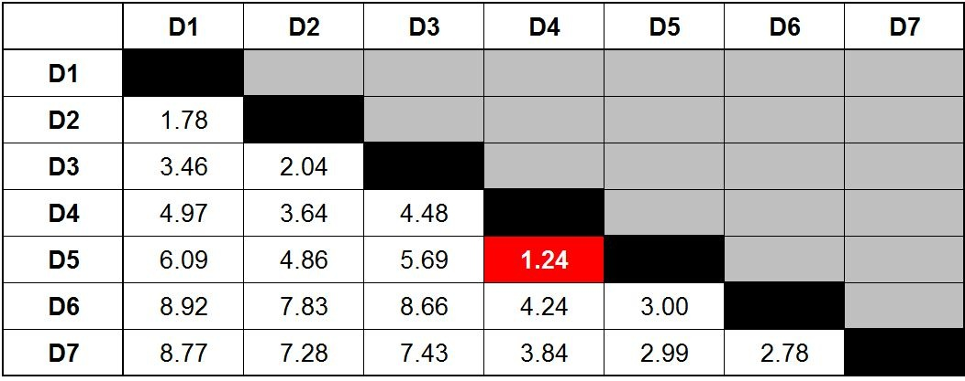
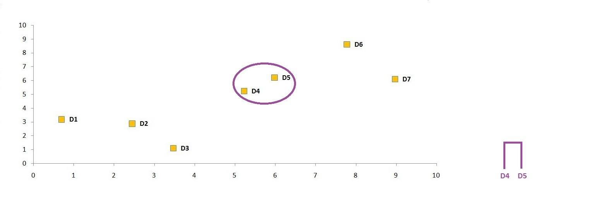
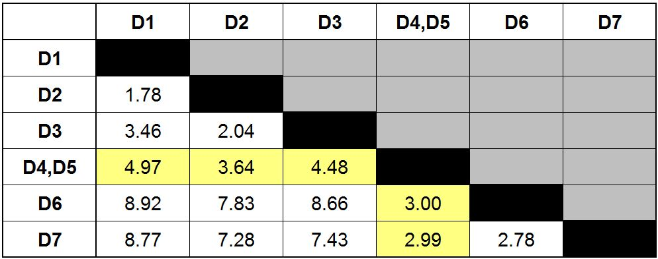
Hot it works – Step 1

Slide 8
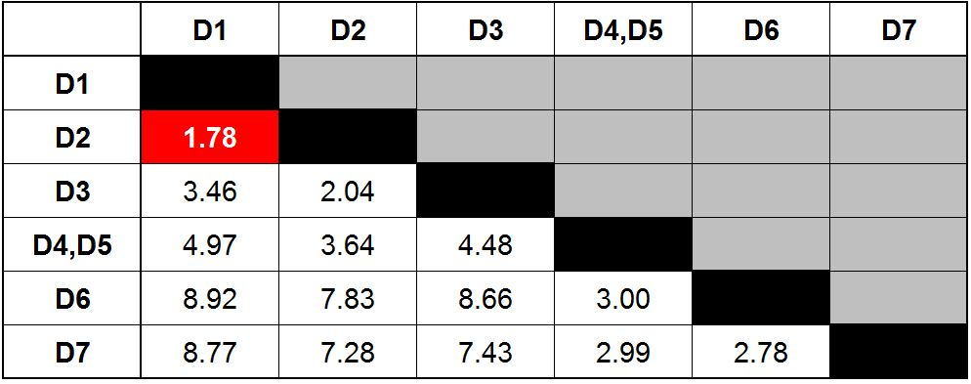
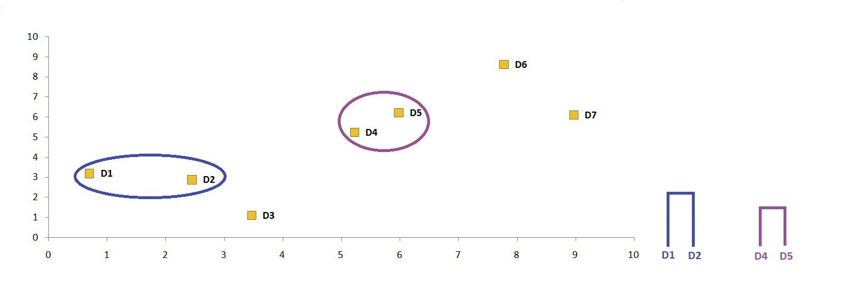
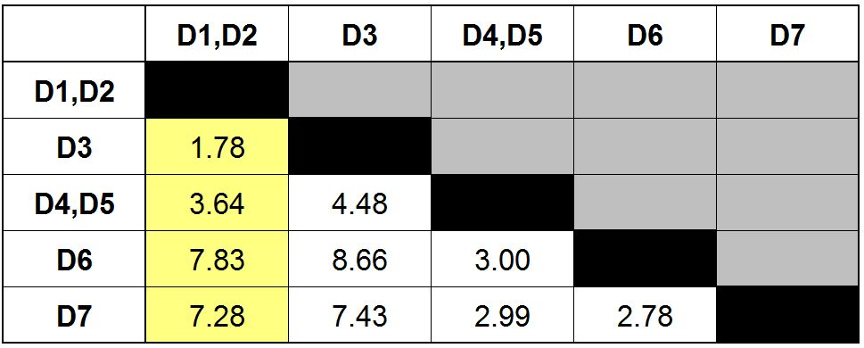
Hot it works – Step 2

Slide 9
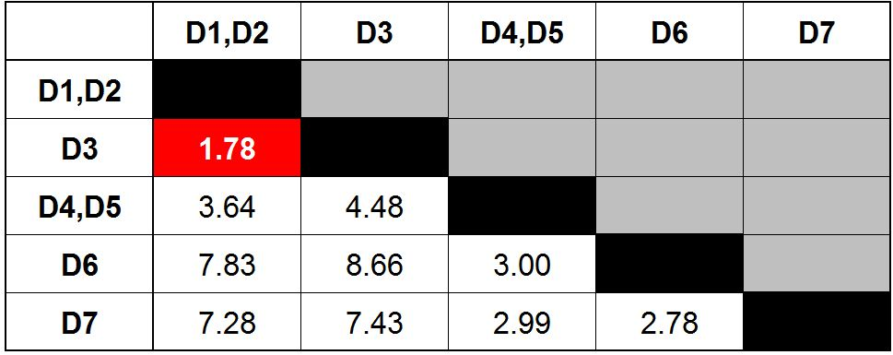
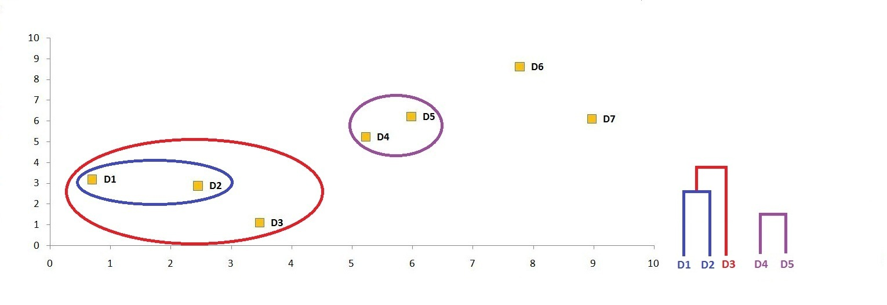
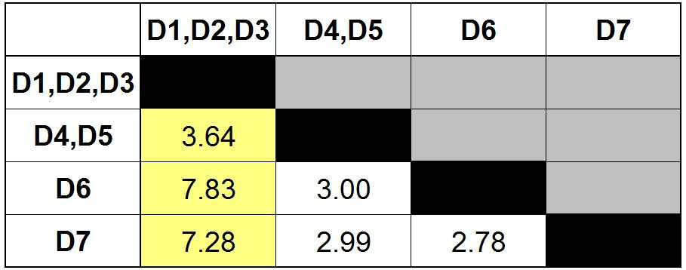
Hot it works – Step 3

Slide 10
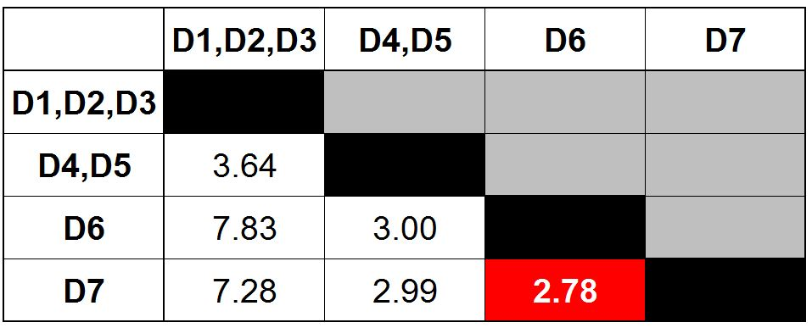
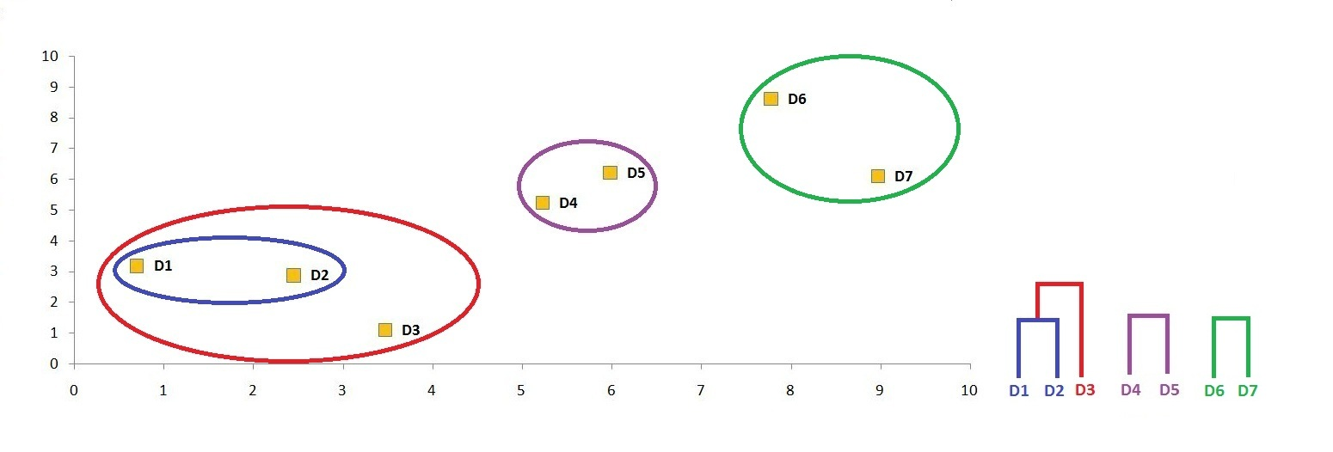
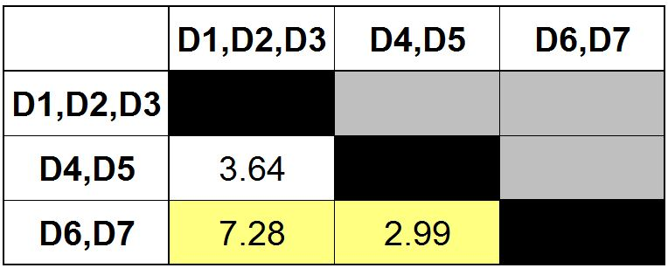
Hot it works – Step 4

Slide 11
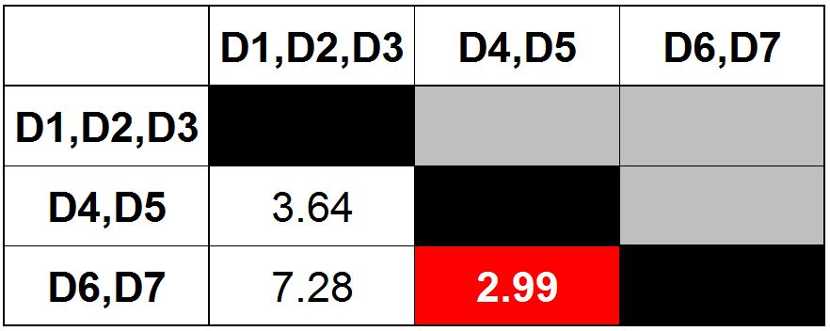
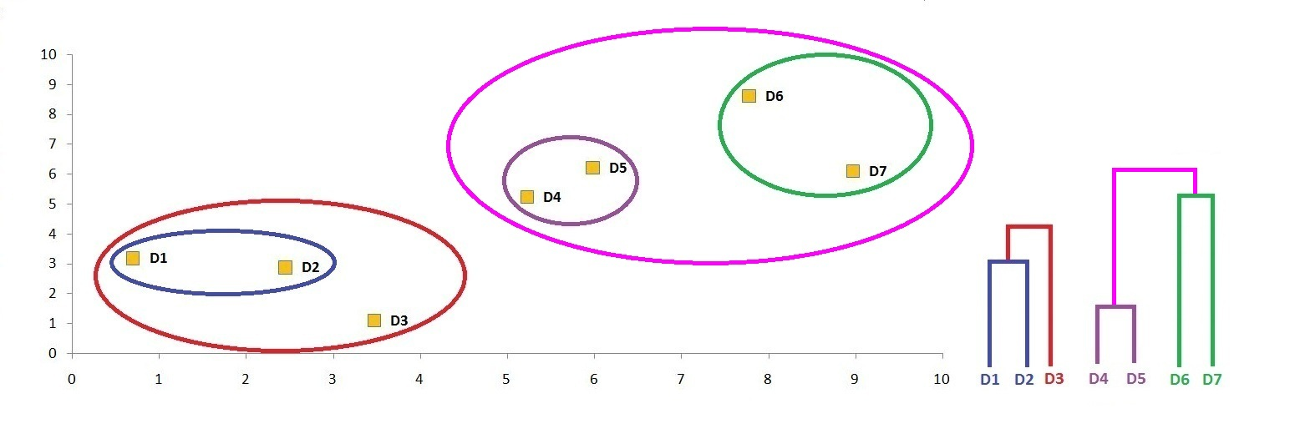
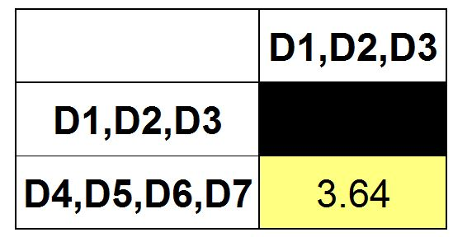
Hot it works – Step 5
Output
[0, 0, 0, 1, 1, 1, 1]

Slide 12
Pseudocode Algorithm (for single linkage)
HCA(dist_mtx[N][N] , n_clusters)
Initialize: result_vector = each point is a cluster // [[0], [1], [2], [3]…..[N]]
(number_current_clusters = N)
While (number_current_clusters > n_clusters)
Find 2 closest clusters from distance matrix
For each distance of point(column/row) of cluster_1
For each distance of point(column/row) of cluster_2
Update if smaller than the current minimal distance
Update result_vector

Slide 13
Pseudocode Algorithm Optimization 1 (for single linkage)
HCA1(dist_mtx[N][N] , n_clusters)
Initialize: result_vector = each point is a cluster // [[0], [1], [2], [3]…..[N]]
(number_current_clusters = N)
While (number_current_clusters > n_clusters)
Find 2 closest clusters from distance matrix
Update matrix with minimum of the two columns (and rows), only one column/row represents the new cluster
Update result_vector

Slide 14
Pseudocode Algorithm Optimization2 (for single linkage)
HCA2(dist_mtx[N][N] , n_clusters)
Initialize: result_vector = each point is a cluster // [[0], [1], [2], [3]…..[N]]
(number_current_clusters = N)
nearest_cluster = N-array that each cluster(array index) contains the nearest cluster
While (number_current_clusters > n_clusters)
Find 2 closest clusters from nearest_cluster
Update matrix with minimum of the two columns (and rows), only one column/row represents the new cluster
Update nearest_cluster
Update result_vector

Slide 15
CODE OPTIMIZATION
C++
Dynamic allocations!
References
Pointers
Python
NumPy library!

Slide 16

pros and cons
C++
PROS
Dynamic allocation
OOP
References
Pointers
CONS
No garbage collector
Less readable code
Python
PROS
Many efficient libraries (built in code optimization)
Much less code
CONS
No dynamic allocations

Slide 17
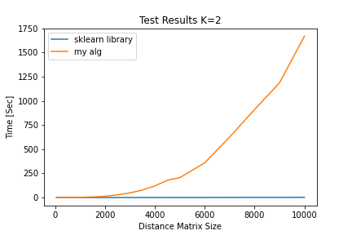
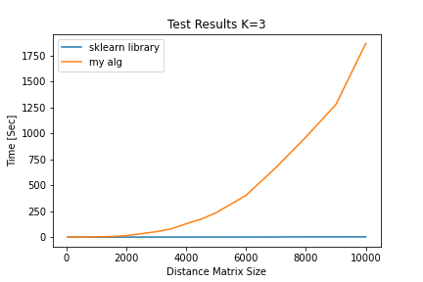

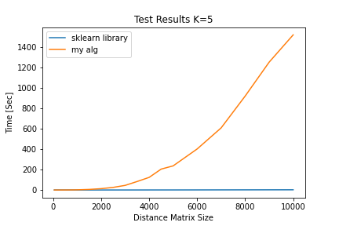
Runtime Comparison – PYTHON – after 1 optimization

Slide 18
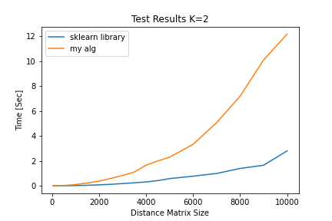
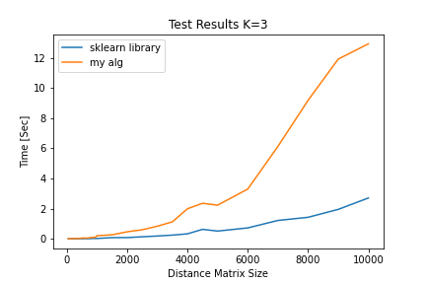

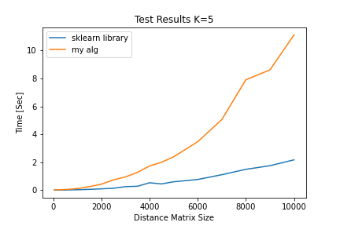
Runtime Comparison - PYTHON – after all optimizations

Slide 19
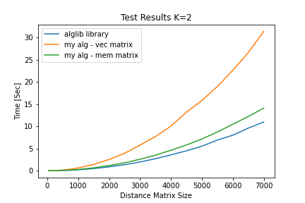



Runtime Comparison – CPP – after all optimizations

Slide 20
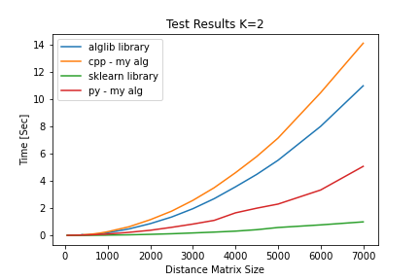
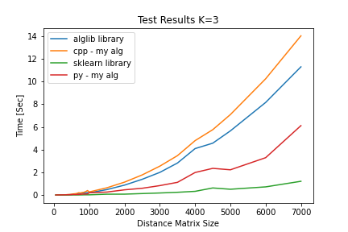
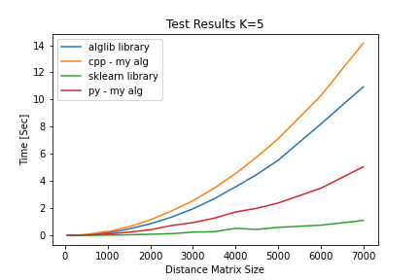
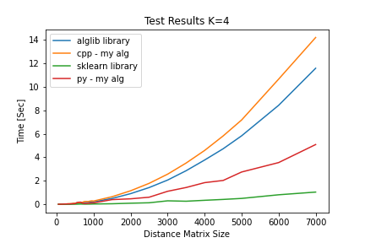
Runtime Comparison – python vs cpp – all optimizations

Slide 21
Runtime Comparison – PYTHON | K = 2
matrix size | after 1 optimization [sec] | after all optimizations [sec] | sklearn [sec]
50 | 0.002 | 0.002 | 0.010
100 | 0.004 | 0.009 | 0.001
150 | 0.011 | 0.011 | 0.001
200 | 0.021 | 0.014 | 0.001
250 | 0.036 | 0.014 | 0.002
300 | 0.054 | 0.021 | 0.002
350 | 0.078 | 0.019 | 0.002
400 | 0.100 | 0.026 | 0.004
450 | 0.141 | 0.027 | 0.005
500 | 0.207 | 0.033 | 0.007
550 | 0.257 | 0.036 | 0.007
600 | 0.331 | 0.041 | 0.007
650 | 0.450 | 0.049 | 0.008
700 | 0.678 | 0.057 | 0.009
750 | 0.692 | 0.061 | 0.010
800 | 1.082 | 0.068 | 0.012
850 | 0.990 | 0.077 | 0.013
matrix size | after 1 optimization [sec] | after all optimiztions [sec] | sklearn [sec]
850 | 0.990 | 0.077 | 0.013
900 | 1.286 | 0.079 | 0.014
950 | 1.462 | 0.091 | 0.016
1000 | 1.794 | 0.101 | 0.021
1500 | 6.449 | 0.225 | 0.042
2000 | 13.859 | 0.376 | 0.078
2500 | 27.768 | 0.592 | 0.121
3000 | 48.438 | 0.832 | 0.179
3500 | 77.798 | 1.103 | 0.241
4000 | 120.452 | 1.655 | 0.312
4500 | 178.479 | 1.997 | 0.419
5000 | 205.664 | 2.299 | 0.579
6000 | 358.853 | 3.331 | 0.771
7000 | 625.602 | 5.067 | 0.992
8000 | 910.086 | 7.200 | 1.391
9000 | 1186.094 | 10.107 | 1.654
10000 | 1667.965 | 12.186 | 2.804

Slide 22
Runtime Comparison – CPP – after all optimizations | K = 2
matrix size | vec matrix [sec] | mem matrix [sec] | alglib [sec]
50 | 0.001 | 0.001 | 0
100 | 0.007 | 0.004 | 0.001
150 | 0.016 | 0.009 | 0.003
200 | 0.023 | 0.009 | 0.005
250 | 0.038 | 0.015 | 0.009
300 | 0.054 | 0.021 | 0.012
350 | 0.072 | 0.03 | 0.017
400 | 0.095 | 0.039 | 0.062
450 | 0.142 | 0.06 | 0.03
500 | 0.149 | 0.062 | 0.038
550 | 0.177 | 0.073 | 0.047
600 | 0.213 | 0.088 | 0.06
650 | 0.254 | 0.102 | 0.066
700 | 0.297 | 0.121 | 0.081
750 | 0.341 | 0.146 | 0.095
800 | 0.387 | 0.164 | 0.112
matrix size | vec matrix [sec] | mem matrix [sec] | alglib [sec]
850 | 0.442 | 0.189 | 0.13
900 | 0.494 | 0.219 | 0.15
950 | 0.559 | 0.241 | 0.172
1000 | 0.625 | 0.273 | 0.192
1500 | 1.411 | 0.634 | 0.476
2000 | 2.522 | 1.153 | 0.864
2500 | 3.921 | 1.779 | 1.349
3000 | 5.768 | 2.571 | 1.959
3500 | 7.691 | 3.499 | 2.695
4000 | 10.055 | 4.6 | 3.564
4500 | 13.199 | 5.791 | 4.479
5000 | 15.809 | 7.143 | 5.514
5500 | 18.995 | 8.729 | 6.894
6000 | 22.634 | 10.473 | 8.002
6500 | 26.66 | 12.215 | 9.59
7000 | 31.421 | 14.105 | 10.979
10000 | 66.115 | 30.403 | ~21.500

Slide 23
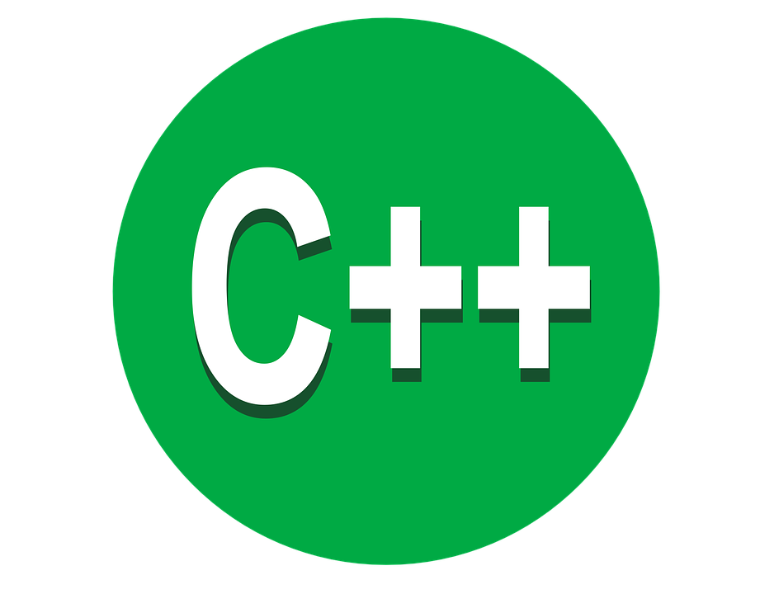

Implementation

